Slide 1
Antimicrobial resistance and microbiome database resources
Notes:
For this next section, we are going to focus on one of the most important components of the AMR++ pipeline, which are the databases that it utilizes.
The databases are so important because they are what we use to identify DNA of interest within our sequence data.
Basically we do an “all-vs-all” comparison of the sequence reads (that made it through the QC steps) to the entries in our reference database, and if we find a sequence match that meets our quality check then we report that we have identified some specific sequence within our sample.

Slide 2
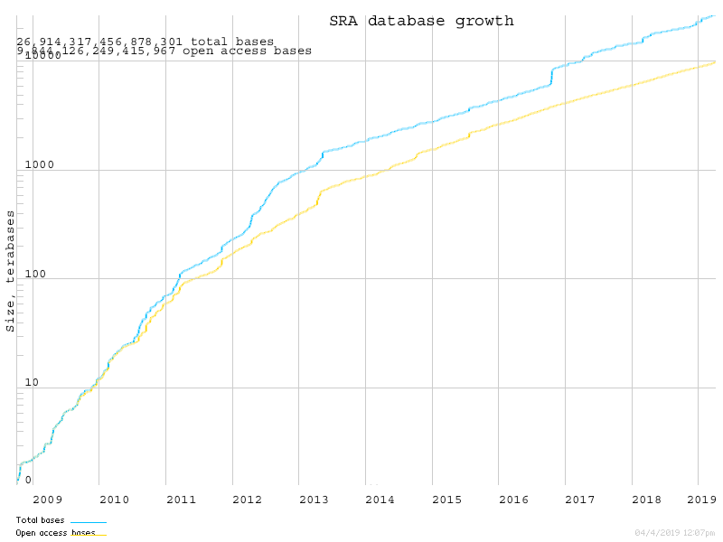
There’s a LOT of sequence data out there:
https://www.ncbi.nlm.nih.gov/sra/docs/sragrowth/
Notes:
A lot of sequence data is being generated these days.
This is a screenshot from the National Center for Biotechnology Information (NCBI for short) short read archive (SRA)
If you generate shotgun data you will often submit it to the SRA database to make it public either before or after you publish the work.
We have years on the x-axis up until 2019 and on the y-axis we have the size of the SRA in Terabases.
You can see that the SRA has been growing pretty quickly – over 26 quadrillion bases as shown by the blue line, 9 quadrillion of that is open access (orange line).

Slide 3
Who (or what) is curating all of it?
NCBI SRA: individual submitters
Metadata is optional
Lacks quality control ➝ variability in usability of data
NCBI RefSeq: curation
Selected assembled genomes from individual species
Custom annotation pipeline
Quality control checks
Notes:
And so this begs the question, who is curating all of these data?
For the SRA database, it’s each individual submitter.
When you submit samples to the SRA you upload your sequences and you can include as much or as little information, what we call “metadata”, as you want
the type of sample, where it was collected, the conditions it was collected under-any information that relates to how the sequence data was generated.
But you don’t really have to upload any of the information when you submit and there are plenty of sequences in there with almost no metadata associated with them
there’s also no real quality control- you can upload raw sequence data that has low quality
so there a huge amount of variability in how usable the data is and it’s frequently not clear what’s good and what’s not.
NCBI has other databases that are more curated.
For instance, RefSeq has whole genome sequences from individual isolates of individual species.
These sequences are run through a custom NCBI pipeline to assemble them and there are control checks along the way to make sure sequences are accurate.
We’ll talk more about this database in a little bit.

Slide 4
It’s important to understand your database
How was the database developed?
How “good” are its sources?
How closely has it been checked for inaccuracies or inconsistencies?
How comprehensive is it?
Notes:
As I already mentioned, the reference database is the really the core of the AMR++ pipeline because this is how we identify what is in our sample- both the genes and microbes.
So what database you use can really change your results.
So when you’re start considering what reference databases to use for your analyses it important to understand your database in terms of both benefits and the limitations.
Think about:
How was the database developed?
How “good” are its sources?
How closely has it been checked for inaccuracies or inconsistencies?
How comprehensive is it?

Slide 5
AMR++ uses two main databases

Slide 6
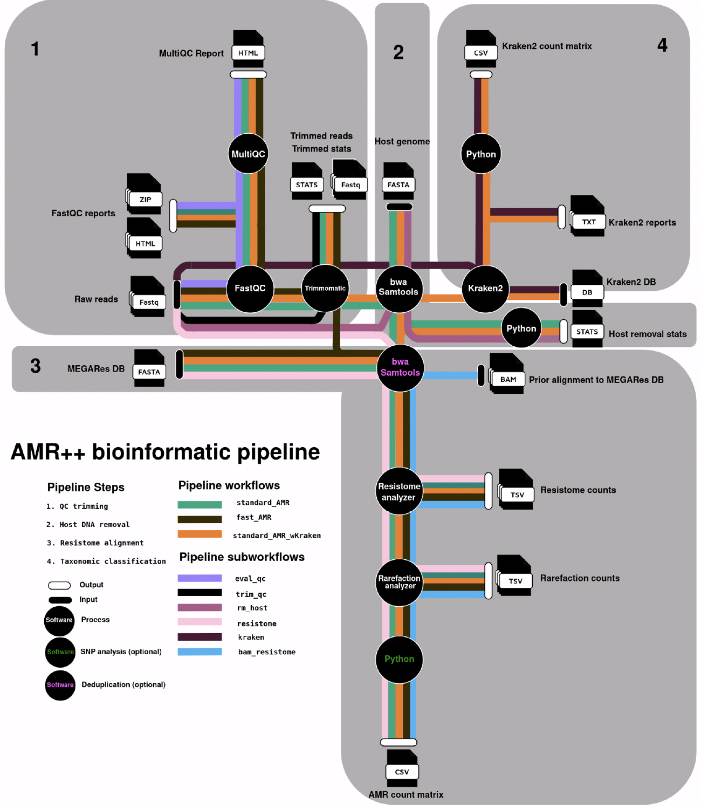
Notes:
- So how do we actually correct for Illumina systemic bias?
- We do this with read trimming, which is done as the first step in the AMR++ pipeline.

Slide 7
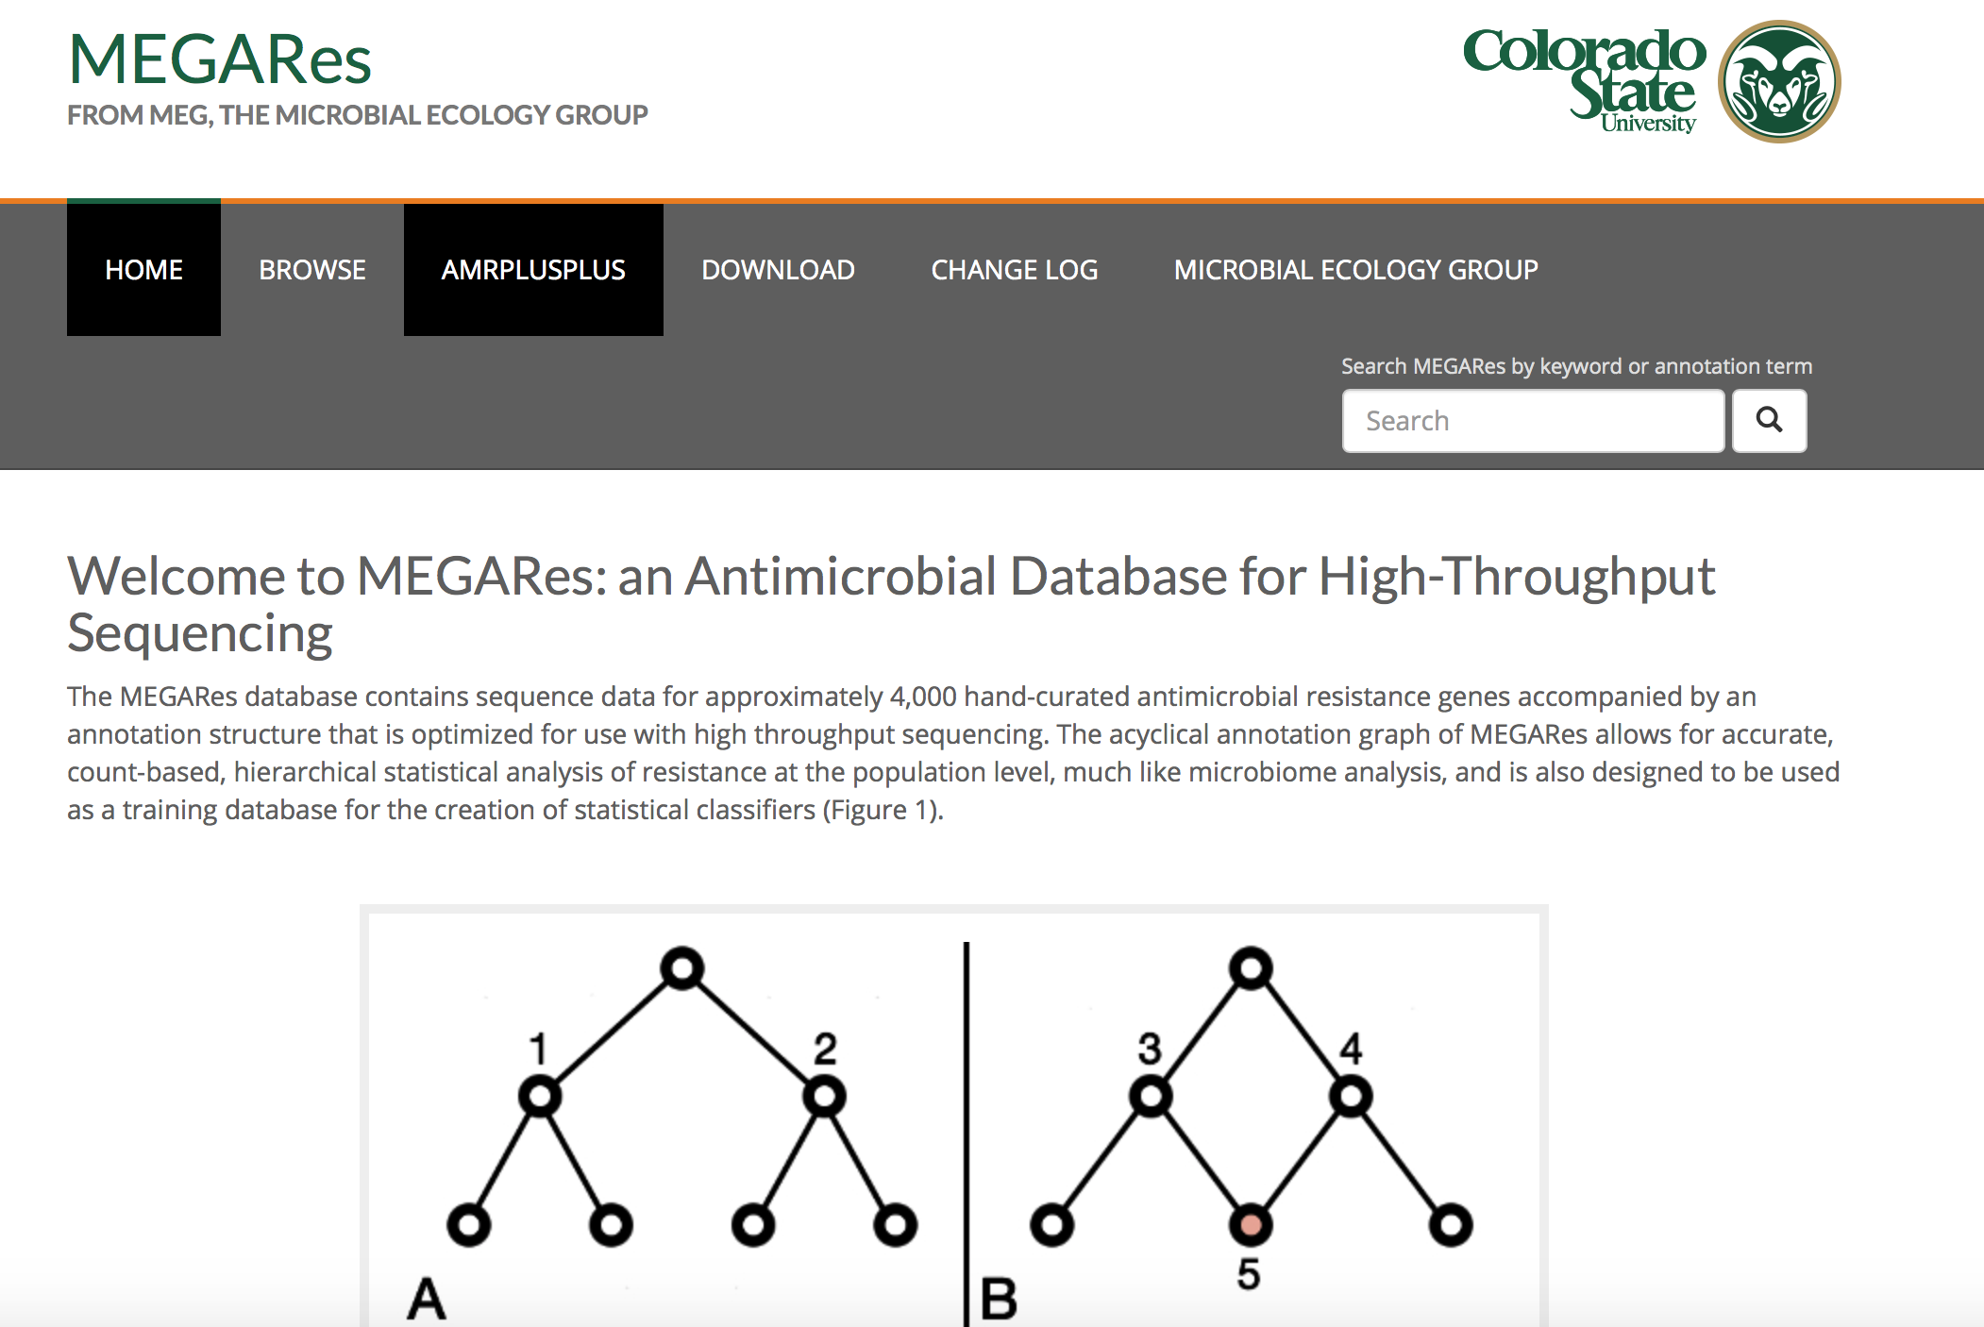
Let’s start with the AMR database
MEGARes pulls accessions from several sources…
CARD
ARG-ANNOT
ResFinder
Lahey Clinical β-lactamase Database (NCBI)
Notes:
And so let’s start with MEGARes.
MEGARes pulls from different existing databases of resistance genes.
So it’s actually a conglomeration of these 4 databases: CARD, ARG-ANNOT, ResFinder, and the Lahey Clinical Beta-lactamase Database.
These 4 databases are:
well-curated
contain just antimicrobial resistance genes
are publicly available
updated fairly frequently
The gene sequences in these 4 databases are all just FASTA files that can be downloaded- so just the name of the sequence and then the sequence of that gene.

Slide 8
So how is MEGARes different then?
The real difference lies in the annotation structure!
(Plus, there’s a lot of manual curation)
Notes:
So that’s really the big difference between these databases and MEGARes.
MEGARes is more than just a sequence name and the sequence.
There is a annotation structure, or ontology, around the sequences in the database that will assist us in running the statistical analyses later on.
So the real difference is in the ontology.
Additionally, the MEGARes team does a lot of manual curation.

Slide 9
Structured Ontology of Microbiome Data
PHYLUM
Proteobacteria
CLASS
Gammaproteobacteria
ORDER
Enterobacteriales
FAMILY
Enterobacteriaceae
GENUS
Escherichia
SPECIES
Escherichia coli
Notes:
What do we mean by annotation structure?
Both microbiome and resistome data have different levels of classification.
For microbiome data, you’ve got our standard taxonomy hierarchy: phylum, class, order, family, genus, and species – I put up the taxonomic levels of E. coli just as an example.

Slide 10
Structured Ontology of Resistome Data
TYPE
Drug
CLASS
Beta-lactam
MECHANISM
Class A beta-lactamases
GROUP
TEM
ACCESSION
bla_{TEM-144} (DQ256080)
Notes:
- For resistance genes, you have a similar structure with 4 classification levels.
- People will talk about class of resistance- such as beta-lactam resistance, tetracycline resistance.
- Then people will talk about a resistance mechanism.
- The resistance group – so here the blaTEM group
- And then you have the lowest level, the individual accession numbers in the database – in this case, the gene blaTEM-144, Accession number DQ256080.

Slide 11
Structured Ontology of Resistome Data
TYPE
Drug
CLASS
Beta-lactam
MECHANISM
Class A beta-lactamases
GROUP
TEM
ACCESSION
bla_{TEM-144} (DQ256080)
Notes:
- For resistance genes, you have a similar structure with 4 classification levels.
- People will talk about class of resistance- such as beta-lactam resistance, tetracycline resistance.
- Then people will talk about a resistance mechanism.
- The resistance group – so here the blaTEM group
- And then you have the lowest level, the individual accession numbers in the database – in this case, the gene blaTEM-144, Accession number DQ256080.

Slide 12
MEGARes structured ontology is acyclical
CARD
determinant of antibiotic resistance
determinant of rifamycin resistance
antibiotic resistant gene variant or mutant
antibiotic target replacement protein
antibiotic resistant rpoB
rifamycin-resistant beta-subunit of RNA polymerase (rpoB)
E. coli rpoB mutant (NC_002695)
Comprehensive Antimicrobial Resistance Database, McArthur et al., 2013
Notes:
In other databases, the graphs can be much more complicated as they have more than 4 levels and one gene can be classified in multiple groups at each level.
Here’s an example from CARD for the rpoB gene that confers resistance to rifampin.
You can see that there are multiple pathways through the graph, which creates cycles within the graph.
For example, at *this* level here, rpoB is classified as an “antibiotic resistant gene variant or mutant”, a “antibiotic target replacement protein”, AND a “determinant of rifamycin resistance”.
And this type of ontology fine for whole genome sequencing where you have organism and you know that one gene comes from that organism.
But when you’re doing metagenomic sequencing and you need to count the number of genes across potentially thousands of species, you really need a more simply structured ontology.
And to some extent, all 4 of the databases AMR++ pulls from are somewhat cyclical in nature.

Slide 13
MEGARes structured ontology is acyclical
MEGARes
CARD
determinant of antibiotic resistance
Rifampin
CLASS
determinant of rifamycin resistance
Rifampin-resistant beta-subunit of RNA polymerase RpoB
antibiotic resistant gene variant or mutant
MECHANISM
antibiotic target replacement protein
antibiotic resistant rpoB
RPOB
GROUP
rifamycin-resistant beta-subunit of RNA polymerase (rpoB)
E. coli rpoB mutant (NC_002695)
ACCESSION
E. coli rpoB mutant (NC_002695)
Comprehensive Antimicrobial Resistance Database, McArthur et al., 2013
Notes:
So here is the same rpoB gene as it’s classified in the MEGARes database.
There are the 4 levels we talked about before, and you can see that it is only classified once at each level.
This is why MEGARes is considered acyclical – there are no cycles within the graph. There is only one pathway through the graph.
And one of the nice things about the MEGARes database is that it’s easily searchable – you can go to the MEGARes website and browse through by class, mechanism, or group.

Slide 14
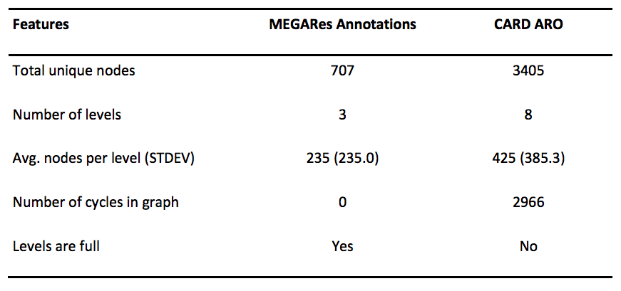
Comparison of annotation structure in MEGARes and CARD
*
Comprehensive Antimicrobial Resistance Database, McArthur et al., 2013
Notes:
So what this ends up meaning is that within MEGARes there are only 707 nodes, with an average of 235 nodes per level.
Compare that to the CARD database where there 8 total classification levels and over 3,000 nodes.
In MEGARes, there are zero cycles in the graph, so everything has ONE, AND ONLY ONE, pathway through the graph
And the levels are full, meaning every gene has an classification at each level.
Again, I want to stress that this doesn’t mean that the CARD is not useful, it just means that these two databases are customized for different functions, with MEGARes more suitable for metagenomic data.

Slide 15
So how is MEGARes different then?
The real difference lies in the structured annotation!
(Plus, there’s a lot of manual curation)
Notes:
So just remember – MEGARes isn’t so much unique in terms of its collection of sequence accessions – instead, it’s unique because of its annotation structure, which makes it well-suited to metagenomic analyses.

Slide 16
Notes:
- So how do we actually correct for Illumina systemic bias?
- We do this with read trimming, which is done as the first step in the AMR++ pipeline.

Slide 17
What is Kraken?
Kraken is actually a program that tries to match your sequence data to all of the genomes in RefSeq (more on this later)…
So really, it’s the NCBI RefSeq database, “manipulated” in a special way
Notes:
Kraken is really more of a program that tries to match your sequence data to all of the genomes in RefSeq – well-curated NCBI databases that has whole genome sequences.
So really it’s the NCBI RefSeq database manipulated in a way to make it usable for microbiome analysis of shotgun metagenomic data
Noelle will talk more about how it does that in a little while…

Slide 18
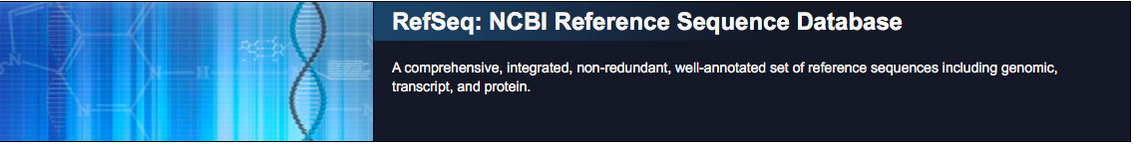
“Comprehensive” – it’s relative
“Integrated” -- ??
“Non-redundant” -- ??
“Well-annotated” -- not really
Notes:
RefSeq claims to be comprehensive, integrated, non-redundant, and well-annotated. Indeed, it is NCBI’s most intensively-curated DB.
However, “comprehensive” is a relative term- it’s based on just what has actually be sequenced.
It’s really not uncommon to get maybe 10% of reads in a sample classified to some known bacterial genome- which means that 90% of the reads didn’t match to anything in RefSeq.
Human samples might be a bit high percent classification just based on what’s been sequenced
So how good your classification is going to be to some extent really depends on the type of sample you’re using.
- “Integrated”…I’m not really sure what that means. Potentially that it’s pulling from multiple sources?
“Non-redundant”- this means there’s only one representative sequence for a gene in that strain in the database.
But strains have a lot of gene redundancy between them and so this really just means non-redundant at the strain level.
And “well-annotated”: there’s actually a lot of problems with the annotations.
For example, sometimes you’ll see a plasmid sequenced with a strain then gets labeled as that strain even though that plasmid could potentially occur in many different strains or species.
And so there are limitations with RefSeq, as with any database out there- all databases have to deal with issue like this. But right now this really is the best out there.

Slide 19
RefSeq Growth Statistics
https://www.ncbi.nlm.nih.gov/refseq/statistics/
Notes:
This is a graph I pulled from RefSeq showing growth over time.
In red is the total number of accession numbers they have, which as of March is over 100 million.
And in blue is the total number of unique species, which as of March, RefSeq contains complete, annotated genomes for 88,816 species.
They also have the counts of nucleotide, protein, and RNA sequences.

Slide 20
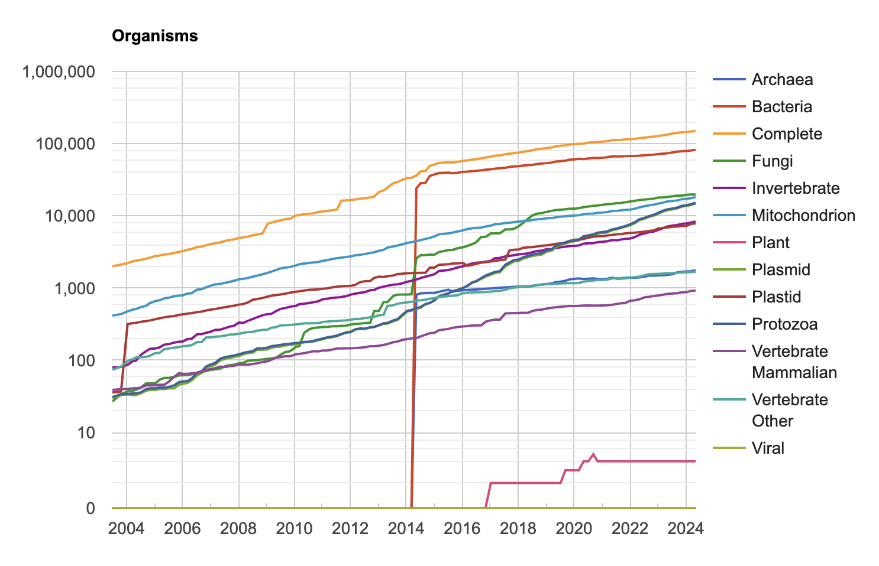
RefSeq Bacteria Growth Statistics
https://www.ncbi.nlm.nih.gov/refseq/statistics/
Notes:
- Looking at Bacteria only…
We still have about about 100 million total accessions- so the vast majority of genomes in RefSeq are prokaryotes.

Slide 21
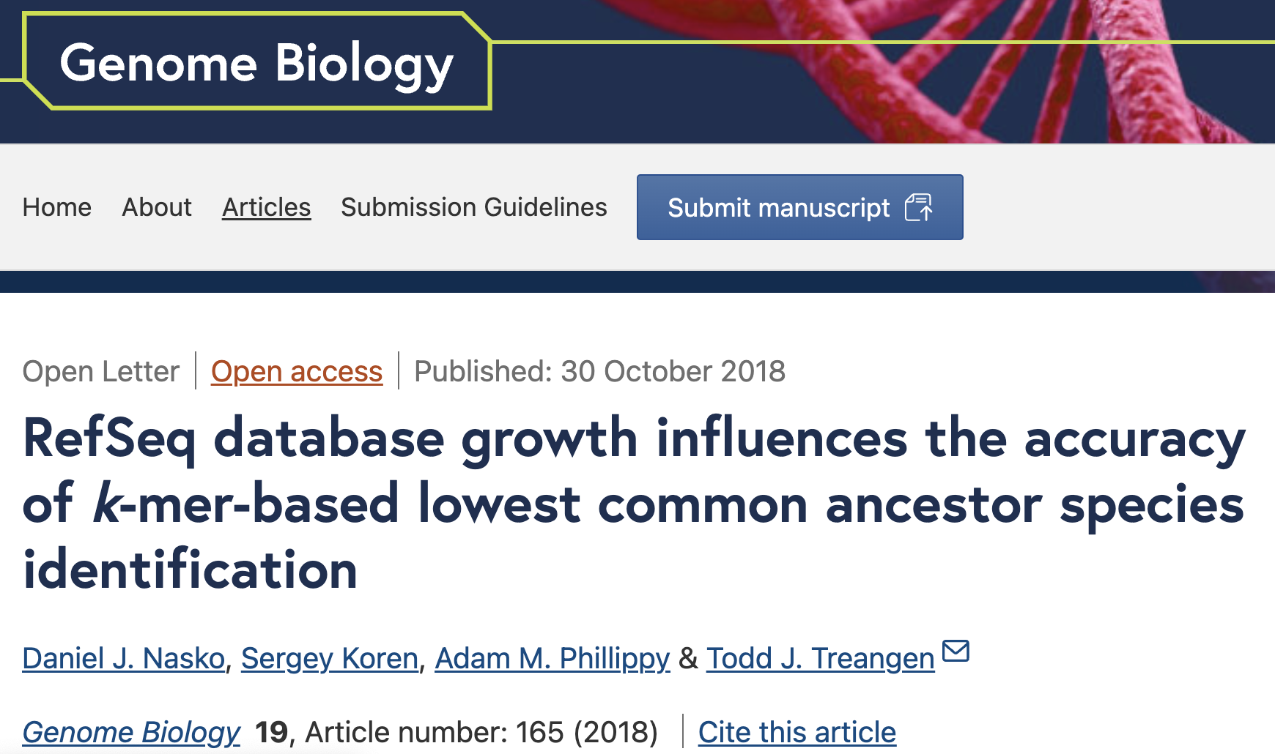
Database size does matter, and there’s good research on this:

Slide 22
How does the “kraken-DB” relate to all of this?
Kraken pulls all of the prokaryotic and viral genomes from RefSeq and does some algorithmic maneuvering to create the “Kraken-DB” (we will discuss the details later)
Then, it uses the NCBI taxonomy to name everything.
Notes:
Kraken pulls all of the prokaryotic genomes along with viral genomes from RefSeq and does some algorithmic maneuvering to create the “Kraken-DB”.
After Kraken does its magic and classifies your DNA sequences, it then uses NCBI taxonomy to name everything that it has identified in your sample.

Slide 23
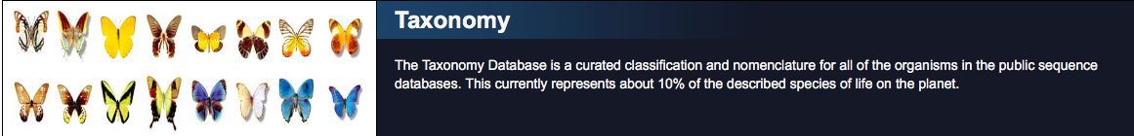
The NCBI Taxonomy Database
Also has its limitations.
In the end, keep in mind that taxonomies are attempting to bin DNA sequences into containers with “hard boundaries”.
Notes:
So the NCBI taxonomy is publicly available, and as you can imagine, the NCBI taxonomy database also has issues.
Yet again, it is probably the best we have currently.
In the end, taxonomies (both microbiome and resistome) are attempting to bin DNA sequences into containers with “hard boundaries”.
When in reality, evolution is a gradual process with fits and starts, and without hard boundaries.
So use the taxonomy for what it’s useful for, and be sure to think about its limitations and how those may impact your analysis.

Slide 24
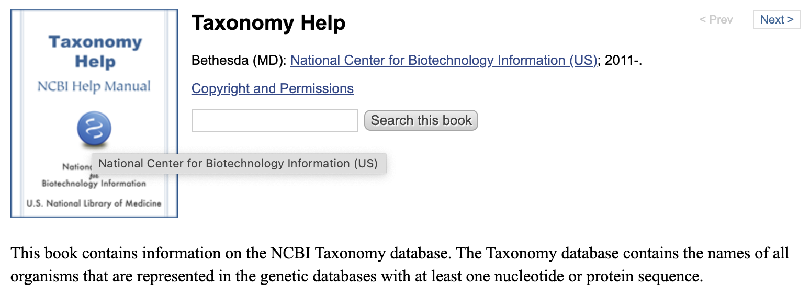
The NCBI Taxonomy Database
Notes:
And should you ever need Taxonomy help….yes, there’s a manual for that.

Slide 25
Notes:
- So how do we actually correct for Illumina systemic bias?
- We do this with read trimming, which is done as the first step in the AMR++ pipeline.

